Slide 1
Bipolar and Related Disorders

Slide 2

It is as if my life were magically run by two electric currents: joyous positive and despairing negative - whichever is running at the moment dominates my life, floods it.
Sylvia Plath (2000)
The Unabridged Journals of Sylvia Plath, 1950-1962
New York: Anchor Books
Notes:
The classic understanding of bipolar (or “manic-depressive”) disorder

Slide 3
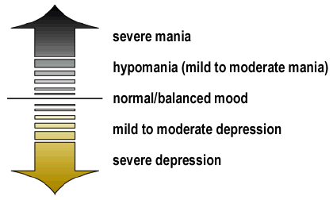
Diagnosis
NIMH (2007)
Notes:
First, let’s take a look at the big picture and this slide provides such…
Consider the various mood states in bipolar disorder as a continuous range. At one end is severe depression, above which is moderate depression and then mild low mood, which many people call "the blues" when it is short-lived but is termed "dysthymia" when it is chronic. Then there is normal or balanced mood, above which comes hypomania (mild to moderate mania), and then severe mania.
In some people, however, symptoms of mania and depression may occur together in what is called a mixed bipolar state. Symptoms of a mixed state often include agitation, trouble sleeping, significant change in appetite, psychosis, and suicidal thinking. A person may have a very sad, hopeless mood while at the same time feeling extremely energized.
Bipolar disorder may manifest as a problem other than mental illness
EG: poor school performance or strained interpersonal relationships.
Such problems in fact may be signs of an underlying mood disorder.

Slide 4
DSM-5 Diagnosis
Diagnostic Classifications
  Bipolar I Disorder
    One or more Manic Episode or Mixed Manic Episode
    Minor or Major Depressive Episodes often present
    May have psychotic symptoms
    Specifiers: anxious distress, mixed features, rapid cycling, melancholic features, atypical features, mood-congruent psychotic features, mood incongruent psychotic features, catatonia, peripartium onset, seasonal pattern
    Severity Ratings: Mild, Moderate, Severe (DSM-5, p. 154)
APA (2013)
Notes:
Bipolar disorder is commonly categorized as either Type I, where an individual experiences full-blown mania, or Type II, in which the hypomanic "highs" do not go to the extremes of mania.
Type II is more difficult to diagnose (hypomanic episodes may simply appear as a period of successful high productivity and is reported less frequently than a distressing depression).
Psychosis can occur in Type I, particularly in manic periods.
There are also 'rapid cycling' subtypes.
Because there is so much variation in severity/nature, the concept of a bipolar spectrum has been offered.
Bipolar Disorder I: In adults, mania is usually episodic with an elevation of mood and increased energy and activity. In children, mania is commonly chronic rather than episodic, and usually presents with irritability, anxiety, and depression (or in mixed states). In adults and children, during depression there is lowering of mood and decreased energy and activity. During a mixed episode both mania and depression can occur on the same day. Many people with bipolar disorder experience severe anxiety and are very irritable (to the point of rage) when in a manic state, while others are euphoric and grandiose.
DSM-5 states prevalence rate of 1.8% in US and non US community samples for pediatric population; 2.7% for youths age 12 years or older
HOWEVER: Since 1990, 40% increase in dx of childhood bipolar disorder
Special Note: Suicide risk much higher in this population: Monitoring is warranted
DSM-5 does not distinguish between child/adolescent onset and adult onset and symptoms
Bi Polar I : Average age of onset 18 for Bipolar I,
ups can be wonderful; eventually euphoria leads to impatient irritability, restless agitation, then utter exhaustion; expressive thoughts may become delusions
Many have lifetime episodes
one or more manic episodes or mixed episodes with or without major depressive episodes. A depressive episode is not required but are often part of the course of the illness.
Full blown mania
In children, mania is commonly chronic rather than episodic, and usually presents with irritability, anxiety, and depression (or in mixed states).
In adults and children, during depression there is lowering of mood and decreased energy and activity.
During a mixed episode both mania and depression can occur on the same day.
Many experience severe anxiety and are very irritable (to the point of rage) when in a manic state OR others are euphoric and grandiose
DSM 5 focuses on increased activity AND energy levels

Slide 5
DSM-5 Diagnosis
Diagnostic Classifications
  Bipolar II Disorder
    One or more Major Depressive Episode
    One or more Hypomanic Episode
    No full Manic or Mixed Manic Episodes
    Specifiers: anxious distress, mixed features, rapid cycling, melancholic features, atypical features, mood-congruent psychotic features, mood incongruent psychotic features, catatonia, peripartium onset, seasonal patter
    Severity Ratings: Mild, Moderate, Severe (DSM-5, p. 154)
APA (2013)
Notes:
Bipolar Disorder II: Characterized by one or more Major Depressive Episodes accompanied by at least one Hypomanic Episode. The key difference between bipolar I and bipolar II is that bipolar II has hypomanic but not manic episodes. In addition, while those with bipolar I disorder may experience additional psychotic symptoms such as delusions and hallucinations, bipolar II by does not have psychotic features.
Bipolar II: average age onset is mid-20’s
Must have major depressive episodes
One clear but hypomanic episode (less sever than manic but same symptoms of elevated mood, expansive self-confidence, infectious joking, increased energy, intrusive sociability, less need for sleep and rest
Key = usually does not cause clinically significant impairment
Never had full-blown manic episode
Bipolar II consisting of recurrent intermittent hypomanic and depressive episodes. [Less severe for of mania(hypomania)]. No full mania or psychotic episodes
One or more Major Depressive Episodes accompanied by at least one Hypomanic Episode.
The key difference between bipolar I and bipolar II is that bipolar II has hypomanic but not manic episodes.
more difficult to diagnose (hypomanic episodes may simply appear as a period of successful high productivity and is reported less frequently than a distressing depression).
bipolar II by does not have psychotic features.

Slide 6
DSM-5 Diagnosis
Diagnostic Classifications
  Cyclothymia
    For at least 2 years (1 in children and adolescents), numerous periods with hypomanic symptoms that do not meet the criteria for hypomanic
      Present at least ½ the time and not without for longer than 2 months
    Criteria for major depressive, manic, or hypomanic episode have never been met
APA (2013)
Notes:
1. Another diagnostic classification is Cyclothymia, which is a chronic, but less extreme/severe, form of bipolar disorder consisting of short periods of depression alternating with short periods of hypomania.
The onset of each phase is separated by short periods of normal mood. This diagnosis is excluded if the patient has had either a full blown manic episode or a major depressive episode. A single episode of hypomania is sufficient to diagnose cyclothymic disorder; however, most individuals also have periods of depression.
Cyclothymia is a form of bipolar disorder, consisting of recurrent hypomanic symptoms, but no full manic episodes or full major depressive episodes.
chronic, but less extreme/severe, form of bipolar disorder consisting of short periods of depression alternating with short periods of hypomania.
The onset of each phase is separated by short periods of normal mood.
This diagnosis is excluded if the patient has had either a full blown manic episode or a major depressive episode – if this occurs than change to major depressive disorder to Bipolar 1
A single episode of hypomania is sufficient to diagnose cyclothymic disorder; however, most individuals also have periods of depression.
Unspecified Bipolar and Related Disorder (comparable to BP-NOS in DSM-IV-TR)
Symptoms characteristic of bipolar and related disorder but do not meet full criteria …
Most use BPNOS for children
adult criteria require well-defined and discrete episodes of abnormal mood and this is often missing in children
childhood onset frequently has insidious onset with affective storms
Some studies have shown a 40% increase in BPNOS diagnosis with children/adolescents
*Berstein, B & Pataki, C. (2011). Pediatric Bipolar Affective Disorder: Background, http://edmedicine.medscape.com/article/913464-overview.]

Slide 7
DSM-5 Diagnosis
Diagnostic Classifications
  Unspecified Bipolar and Related Disorder
    Bipolar features that do not meet criteria for any specific bipolar disorder.
APA (2013)
Notes:
2. If an individual clearly seems to be suffering from some type of bipolar disorder, but does not meet the criteria for one of the conditions laid out above, he or she receives a diagnosis of Bipolar Disorder NOS (Not Otherwise Specified). Many times pediatric bipolar disorder is classified NOS.
Unspecified Bipolar and Related Disorder (comparable to BP-NOS in DSM-IV-TR)
Symptoms characteristic of bipolar and related disorder but do not meet full criteria …
Most use BPNOS for children
adult criteria require well-defined and discrete episodes of abnormal mood and this is often missing in children
childhood onset frequently has insidious onset with affective storms
Some studies have shown a 40% increase in BPNOS diagnosis with children/adolescents

Slide 8

DSM-5 Diagnosis
Manic Episode Criteria
  A distinct period of abnormally and persistently elevated, expansive, or irritable mood.
  Lasting at least 1 week.
  Three or more (four if the mood is only irritable) of the following symptoms:
    Inflated self-esteem or grandiosity
    Decreased need for sleep
    Pressured speech or more talkative than usual
    Flight of ideas or racing thoughts
    Distractibility
    Psychomotor agitation or increase in goal-directed activity
    Hedonistic interests
APA (2013
Notes:
Inflated self-esteem or grandiosity
Decreased need for sleep (e.g., feels rested after only 3 hours of sleep)
More talkative than usual or pressure to keep talking
Flight of ideas or subjective experience that thoughts are racing
Distractibility (i.e., attention too easily drawn to unimportant or irrelevant external stimuli)
Increase in goal-directed activity (either socially, at work or school, or sexually) or psychomotor agitation
Excessive involvement in pleasurable activities that have a high potential for painful consequences (e.g., engaging in unrestrained buying sprees, sexual indiscretions, or foolish business investments)

Slide 9
DSM-5 Diagnosis
Manic Episode Criteria (cont.)
  Causes marked impairment in occupational functioning in usual social activities or relationships, or
  Necessitates hospitalization to prevent harm to self or others, or
  Has psychotic features
  Not due to substance use or abuse (e.g., drug abuse, medication, other treatment), or a general medial condition (e.g., hyperthyroidism).
  A full manic episode emerging during antidepressant treatment
APA (2013)
Notes:
NOTE: A full manic episode that emerges during antidepressant treatment (e.g., medication, electroconvulsive therapy) but persists at a fully syndromal level beyond the physiological effect of that treatment is sufficient evidence for a manic episode and therefore a bipolar I diagnosis.

Slide 10
Diagnosis: Manic Symptoms
Symptom/Definition | Example
Euphoria: Elevated (too happy, silly, giddy) and expansive (about everything) mood, “out of the blue” or as an inappropriate reaction to external events for an extended period of time. | A child laughs hysterically for 30 minutes after a mildly funny comment by a peer and despite other students staring at him.
Irritability: Energized, angry, raging, or intensely irritable mood, “out of the blue” or as an inappropriate reaction to external events for an extended period of time. | In reaction to meeting a substitute teacher, a child flies into a violent 20-minute rage.
Inflated Self-Esteem or Grandiosity: Believing, talking or acting as if he is considerably better at something or has special powers or abilities despite clear evidence to the contrary | A child believes and tells others she is able to fly from the top of the school building.
From Lofthouse & Fristad (2006, p. 215)
Notes:
What the school psychologist may see that may be pediatric bipolar disorder (from a chapter in the NASP publication Children’s Needs III).

Slide 11
Diagnosis: Manic Symptoms
Symptom/Definition | Example
Decreased Need for Sleep: Unable to fall or stay asleep or waking up too early because of increased energy, leading to a significant reduction in sleep yet feeling well rested. | Despite only sleeping 3 hours the night before, a child is still energized throughout the day
Increased Speech: Dramatically amplified volume, uninterruptible rate, or pressure to keep talking. | A child suddenly begins to talk extremely loudly, more rapidly, and cannot be interrupted by the teacher
Flight of Ideas or Racing Thoughts: Report or observation (via speech/writing) of speeded-up, tangential or circumstantial thoughts | A teacher cannot follow a child’s rambling speech that is out of character for the child (i.e., not related to any cognitive or language impairment the child might have)
From Lofthouse & Fristad (2006, p. 215)

Slide 12
Diagnosis: Manic Symptoms
Symptom/Definition | Example
Distractibility: Increased inattentiveness beyond child’s baseline attentional capacity. | A child is distracted by sounds in the hallway, which would typically not bother her.
Increase in Goal-Directed Activity or Psychomotor Agitation: Hyper-focused on making friends, engaging in multiple school projects or hobbies or in sexual encounters, or a striking increase in and duration of energy.. | A child starts to rearrange the school library or clean everyone’s desks, or plan to build an elaborate fort in the playground, but never finishes any of these projects.
Excessive Involvement in Pleasurable or Dangerous Activities: Sudden unrestrained participation in an action that is likely to lead to painful or very negative consequences. | A previously mild-mannered child may write dirty notes to the children in class or attempt to jump out of a moving school bus.
From Lofthouse & Fristad (2006, p. 215)

Slide 13
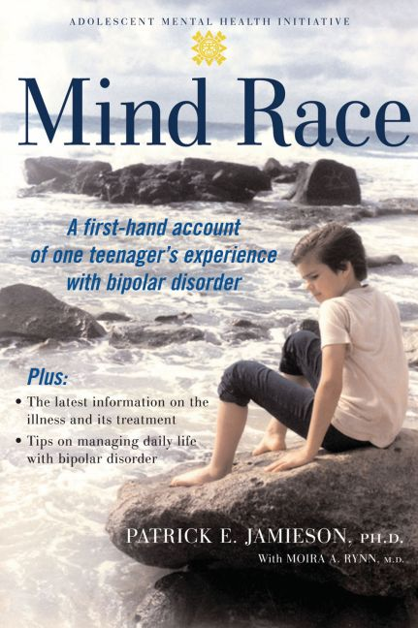
Life feels like it is supercharged with possibility… Ordinary activities are extraordinary!” “I become the Energizer Bunny on a supercharger. ‘Why does everybody else need so much sleep?’ I wonder…. Hours pass like minutes, minutes like seconds. If I sleep it is briefly, and I awake refreshed, thinking, ‘This is going to be the best day of my life!’
Patrick E. Jamieson & Moira A. Rynn (2006)
Mind Race:
A Firsthand Account of One Teenager’s Experience with Bipolar Disorder.
New York: Oxford University Press
Notes:
Here are some more quotes of individuals with early-onset bipolar disorder from another book titled: “Intense Minds” by Tracy Anglada.
“It feels like I don’t know what to do all of the time, because I don’t know which thought to pick in my head. They are all scrambled.” Alisha, age 7
“My thoughts could race so much that I wouldn’t be able to think straight or concentrate on anything because there would be many thoughts going around in my head at once. It’s like everyone who needed me to answer a question or needed me to do something for them and everything that I needed to do was all swirling around in my mind in a big ball. Every once in a while I could catch a thought, but I couldn’t do anything about that thought because of all the swirling.” Joan
“I would toss and turn and have the feeling that my skeleton was going to simply burst through my skin unless I got up and did something.” Grace

Slide 14
DSM-5 Diagnosis
Hypomanic Criteria
  Similarities with Manic Episode
    Same symptoms
  Differences from Manic Episode
    Length of time
    Impairment not as severe
    May not be viewed by the individual as pathological
      However, others may be troubled by erratic behavior
APA (2013)
Notes:
Hypomania literally means mild mania. Decreased need for sleep and lack of daytime fatigue are red flags. The symptoms are the same as for a Manic Episode. To differentiate from manic, consider the length of time and severity of the impairment. Hypomania is characterized by a CHANGE in functioning that is uncharacteristic and observable to others, whereas mania causes marked IMPAIRMENT in functioning.
Individuals in a hypomanic state don’t usually view it as bad, and may feel more confident, more gregarious or outgoing, or more energetic.
Not likely to get treatment, or even to be recognized as pathological. A state likely missed in initial diagnosis (the individual may not even remember hypomania).
In addition to looking for a decreased need for sleep and lack of daytime fatigue, also ask about periods where the person feels really good, can conquer the world, is going to have great things happen, etc. And the flip side… inquire about periods of time where they may be irritable, have lots of thoughts going through head, need to get lots of things accomplished, and feel that others are moving too slowly.

Slide 15
DSM-5 Diagnosis
Major Depressive Episode Criteria
  A period of depressed mood or loss of interest or pleasure in nearly all activities
    In children and adolescents, the mood may be irritable rather than sad.
  Lasting consistently for at least 2 weeks.
  Represents a significant change from previous functioning.
APA (2013)

Slide 16

DSM-5 Diagnosis
Major Depressive Episode Criteria (cont.)
  Five or more of the following symptoms (at least one of which is either (1) or (2):
    Depressed mood
    Diminished interest in activities
    Significant weight loss or gain
    Insomnia or hypersomnia
    Psychomotor agitation or retardation
    Fatigue/loss of energy
    Feelings of worthlessness/inappropriate guilt
    Diminished ability to think or concentrate/indecisiveness
    Suicidal ideation or suicide attempt
APA (2013)
Notes:
Depressed mood most of the day, nearly every day as indicated by either subjective report (e.g., feels sad or empty) or observation made by other (e.g., appears tearful). Note: In children and adolescents, can be irritable mood.
Markedly diminished interest or pleasure in all, or almost all, activities most of the day, nearly every day (as indicated by either subjective account or observation made by others).
Significant weight loss when not dieting or weight gain (e.g., a change of more that 5% of body weight in a month), or decrease or increase in appetite nearly every day. Note: In children, consider failure to make expected weight gains.
Insomnia or hypersomnia nearly every day.
Psychomotor agitation or retardation nearly every day (observable by others, not merely subjective feelings of restlessness or being slowed down). These children are clumsy and often have difficult with PE.
Fatigue or loss of energy nearly every day.
Feelings of worthlessness or excessive or inappropriate guilt (which may be delusional) nearly every day (not merely self-reproach or guilt about being sick).
Diminished ability to think or concentrate, or indecisiveness, nearly every day (either by subjective account or as observed by others).
Recurrent thoughts of death (not jus fear of dying), recurrent suicidal ideation without a specific plan, or a suicide attempt or a specific plan for committing suicide.
NOTE: Bipolar Depressive Triad = (a) Over-eating, (b) over-sleeping, and (c) excessive physical fatigue may differential bipolar depression from other mood disorders

Slide 17
DSM-5 Diagnosis
Major Depressive Episode Criteria (cont.)
  Causes marked impairment in occupational functioning or in usual social activities or relationships
  Not due to substance use or abuse, or a .general medial condition
  Not better accounted for by Bereavement
    After the loss of a loved one, the symptoms persist for longer than 2 months or are characterized by marked functional impairment, morbid preoccupation with worthlessness, suicidal ideation, psychotic symptoms, or psychomotor retardation
APA (2013)

Slide 18
Diagnosis: Major Depressive Symptoms at School
Symptom/Definition | Example
Depressed Mood: Feels or looks sad or irritable (low energy) for an extended period of time. | A child appears down or flat or is cranky or grouchy in class and on the playground.
Markedly Diminished Interest or Pleasure in All Activities: Complains of feeling bored or finding nothing fun anymore. | A child reports feeling empty or bored and shows no interest in previously enjoyable school or peer activities.
Significant Weight Lost/Gain or Appetite Increase/Decrease: Weight change of >5% in 1 month or significant change in appetite. | A child looks much thinner and drawn or a great deal heavier, or has no appetite or an exce3sive appetite at lunch time.
From Lofthouse & Fristad (2006, p. 216)

Slide 19
Diagnosis: Major Depressive Symptoms at School
Symptom/Definition | Example
Insomnia or Hypersomnia: Difficulty falling asleep, staying asleep, waking up too early or sleeping longer and still feeling tired. | A child looks worn out, is often groggy or tardy, or reports sleeping through alarm despite getting 12 hours of sleep.
Psychomotor Agitation/Retardation: Looks restless or slowed down. | A child is extremely fidgety or can’t say seated. His speech or movement is sluggish or he avoids physical activities.
Fatigue or Loss of Energy: Complains of feeling tired all the time | Child looks or complains of constantly feeling tired even with adequate sleep.
From Lofthouse & Fristad (2006, p. 216)

Slide 20
Diagnosis: Major Depressive Symptoms at School
Symptom/Definition | Example
Low Self-Esteem, Feelings of Worthlessness or Excessive Guilt: Thinking and saying more negative than positive things about self or feeling extremely bad about things one has done or not done. | A child frequently tells herself or others “I’m no good, I hate myself, no one likes me, I can’t do anything.” She feels bad about and dwells on accidentally bumping into someone in the corridor or having not said hello to a friend.
Diminished Ability to Think or Concentrate, or Indecisiveness: Increase inattentiveness, beyond child’s baseline attentional capacity; difficulty stringing thoughts together or making choices. | A child can’t seem to focus in class, complete work, or choose unstructured class activities.
From Lofthouse & Fristad (2006, p. 216)

Slide 21
Diagnosis: Major Depressive Symptoms at School
Symptom/Definition | Example
Hopelessness: Negative thoughts or statements about the future. | A child frequently thinks or says “nothing will change or will ever be good for me.”
Recurrent Thoughts of Death or Suicidality: Obsession with morbid thoughts or events, or suicidal ideation, planning, or attempts to kill self | A child talks or draws pictures about death, war casualties, natural disasters, or famine. He reports wanting to be dead, not wanting to live anymore, wishing he’d never been born; he draws pictures of someone shooting or stabbing him, writes a suicide note, gives possessions away or tires to kill self.
From Lofthouse & Fristad (2006, p. 216)

Slide 22
DSM-5 Diagnosis
Rapid-Cycling Specifier
  Can be applied to Bipolar I or II
  Four or more mood episodes (i.e., Major Depressive, Manic, Mixed, or Hypomanic) per 12 months
  May occur in any order or combination
  Must be demarcated by …
    a period of full remission, or
    a switch to an episode of the opposite polarity
      Manic, Hypomanic, and Mixed are on the same pole
  NOTE: This definition is different from that used in some literature, where in cycling refers to mood changes within an episode (Geller et al., 2004).
APA (2013)

Slide 23
Changes From DSM-IV-TR
No longer classified as a “mood disorder” – has own category
Placed between the chapters on schizophrenia and depressive disorders
  Consistent with their place between the two diagnostic classes in terms of symptomatology, family history, and genetics.
Bipolar I criteria have not changed
Bipolar II must have hypomanic as well as history of major depression and have clinically significant
  can now include episodes with mixed features.
  past editions, a person who had mixed episodes would not be diagnosed with bipolar II
  diagnosis of hypomania or mania will now require a finding of increased energy, not just change in mood
Source: APA (2013)
Notes:
Specifiers pretty much the same
With rapid cycling
With mood congruent psychotic features
With mood incongruent psychotic features
With catatonia
With seasonal pattern
Has own category in DSM 5 (instead of being under “Mood Disorder); they also moved depression into its own category
Bipolar II must have hypomanic as well as history of major depression and have clinically significant
can now include episodes with mixed features.
Mixed episodes have also been eliminated. Instead of labeling an episode as mixed, the provider will now have the option to specify a manic or depressive episode with a certain specification, “with mixed features” attached to it. The goal is to pinpoint the predominant mood.
Can be applied to episodes of mania or hypomania when depressive features are present, and to episodes of depression in the context of major depressive disorder or bipolar disorder when features of mania/hypomania are present
In past editions, a person who had mixed episodes would not be diagnosed with bipolar II so this allows for placement in “less severe Bipolar II” (although some debate if BPII is less sever than BP1!) http://www.mentalhealthcenter.org/2013/06/changes-to-bipolar-disorder-treatment-in-the-new-dsm-5/

Slide 24
Rationale for DSM-5 Changes
pinpoint the predominant mood (“features”)
a person must now exhibit changes in mood as well as energy
  For example, a person would have to be highly irritable and impulsive in addition to not having a need for sleep
  helps to separate bipolar disorders from other illnesses that may have similar symptoms.
  intention is to cut down on misdiagnosis, resulting in more effective bipolar disorder treatment. -

Slide 25
Possible Consequences of DSM-5
Still does not address potential bipolar children and adolescents
Could miss bipolar in children and then prescribe medication that make symptoms worse
Hopefully will increased accuracy with diagnosis
Notes:
http://shine.yahoo.com/parenting/diagnosing-bipolar-disorder-in-kids--here-s-the-dsm-5-s-controversial-new-update-213957480.html#!jclr5
David Axelson, director of the University of Pittsburgh’s child and adolescent bipolar services outpatient program: if the presence of bipolar is missed, and is instead identified as ADHD, depression or anxiety disorder, which symptoms can mimic, there’s another big risk: “Those medications, when prescribed without mood stabilizing medication, can really worsen, we think, the outcome for kids with bipolar disorder.”
Disruptive Mood Dysregulation Disorder (new disorder is listed under Depressive Disorders) but this is NOT bipolar!

Slide 26
Bipolar I
Alternative Diagnosis | Differential Consideration
Major Depressive Disorder | Person with depressive Sx never had Manic/Hypomanic episodes
Bipolar II | Hypomanic episodes, w/o a full Manic episode
Cyclothymic Disorder | Lesser mood swings of alternating depression -hypomania (never meeting depressive or manic criteria) cause clinically significant distress/impairment
Normal Mood Swings | Alternating periods of sadness and elevated mood, without clinically significant distress/impairment
Schizoaffective Disorder | Sx resemble Bipolar I, severe with psychotic features but psychotic Sx occur absent mood Sx
Schizophrenia or Delusional Disorder | Psychotic symptoms dominate. Occur without prominent mood episodes
Substance Induced Bipolar Disorder | Stimulant drugs can produce bipolar Sx
Source: Francis (2013)

Slide 27
Bipolar II
Alternative Diagnosis | Differential Consideration
Major Depressive Disorder | No Hx of hypomanic (or manic) episodes
Bipolar I | At least 1 manic episode
Cyclothymic Disorder | Mood swings (hypomania to mild depression) cause clinically significant distress/impairment; no history of any Major Depressive Episode
Normal Mood Swings | Alternately feels a bit high and a bit low, but with no clinically significant distress/impairment
Substance Induced Bipolar Disorder | Hypomanic episode caused by antidepressant medication or cocaine
ADHD | Common Sx presentation, but ADHD onset is in early childhood. Course chronic rather than episodic. Does not include features of elevated mood.
Source: Francis (2013)

Slide 28
Cyclothymic Disorder
Alternative Diagnosis | Differential Consideration
Normal Mood Swings | Ups &downs without clinically significant distress/impairment
Major Depressive Disorder | Had a major depressive episode
Bipolar I | At least one Manic episode
Bipolar II | At least one clear Major Depressive episode
Substance Induced Bipolar Disorder | Mood swings caused by antidepressant medication or cocaine. Stimulant drugs can produce bipolar symptoms
Source: Francis (2013)

Slide 29
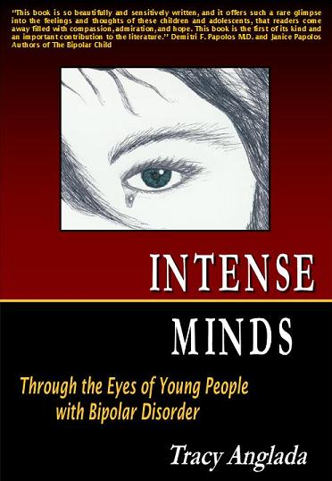
I felt like I was a very old woman who was ready to die. She had suffered enough living.
--- Abbey
Tracy Anglada
Intense Minds: Through the Eyes of Young People with Bipolar Disorder (2006)
Victoria, BC: Trafford Publishing
Notes:
Here are some more quotes:
“Life was a heavy load, and I couldn’t do it right. In fact the load and burden of living was so difficult, and so big, I didn’t think I could accomplish it. I also didn’t know how people could walk down the street looking so happy, because I didn’t know that it wasn’t this way for everyone.” Drew
“I felt so heavy. I felt drug down to the point of it being difficult to even sit up in a chair. I was afraid. I was incapable of doing anything but existing. I remember feeling like I was wading through quicksand, just pushing through something so very heavy. Just walking to another room was a challenge. Sitting up was hard. Speaking was too much.” Lee
“I felt like life was a burden at times. It is like I never got to the point of being finished or accomplished. Every time I made some progress, then there was another step in front of me, but it usually had a negative feeling, and if something big and unexpected happened, I couldn’t cope.” Todd

Slide 30
Co-existing Disabilities
AD/HD Criteria Comparison
Bipolar Disorder (mania)
  1. More talkative than usual, or pressure to keep talking
  2. Distractibility
  3. Increase in goal directed activity or psychomotor agitation
AD/HD
  1. Often talks excessively
  2. Is often easily distracted by extraneous stimuli
  3. Is often “on the go” or often acts as if “driven by a motor”
Differentiation = irritable and/or elated mood, grandiosity, decreased need for sleep, hypersexuality, and age of symptom onset (Geller et al., 1998).
Notes:
We discussed the DSM criteria for a manic phase of bipolar, three of the criteria for ADHD overlap…
A study by Geller and colleagues (1998) indicated that there are some fundamental ways to differentiate between the two. They found that bipolar children are significantly more likely to experience
elated moods (16 times more likely),
grandiosity (11 times more likely),
decreased need for sleep (9 times more likely) ,
hypersexuality (5 times more likely), and
irritable moods (1.5 times more likely).

Slide 31
Associated Impairments
Suicidal Behaviors
Prevalence of suicide attempts
  40-45%
Age of first attempt
Multiple attempts
Severity of attempts
Suicidal ideation
Notes:
With regard to suicide attempts, individuals with BPD have significantly higher rates, even when compared with other psychopathologies such as unipolar depression. Prevalence data indicates that between 40 & 45% of individuals with bpd attempt suicide. Those with a subsyndromal bipolar have been indicated to have a similar rate of suicide attempt as individuals with a unipolar depression, at about 18%.
Individuals with BPD tended to be young when attempting suicide for the first time (around 13 years old), a higher percentage of multiple attempts (87% vs 50% major depression), and have more serious attempts.
In addition, individuals with BPD report significantly more suicidal ideation (thoughts, feelings) than individuals with subsyndromal BPD or unipolar depression (BPD = 72%; SBDP = 41%; udprn = 52%).

Slide 32
Associated Impairments
Cognitive Deficits
Executive Functions
Attention
Memory
Sensory-Motor Integration
Nonverbal Problem-Solving
Academic Deficits
  Mathematics
Notes:
It has been suggested that cognitive deficits are a better predictor of outcome than are symptoms. Recent studies have indicated that there are specific deficits evident across phases (including recovery) and subtypes of the disorder.
Executive functioning deficits have consistently been indicated for individuals with BPD. The domains that are primarily compromised include: problem-solving, planning, self monitoring, and temporal sequencing of information. Executive functions tend to be more impaired during the manic phase. These individuals exhibit more errors due to difficulties with planning and impulse control (response inhibition). Individuals in the depressive phases tend to take longer to respond, and show increased difficulties with decision-making tasks.
Much research has supported BPD individuals difficulty maintaining attention. Specific areas of impairment include: selective, sustained, & set-shifting. Obviously these diff. can be exacerbated by comorbidity with ADHD.
Verbal learning and memory has been one of the deficit areas repeatedly indicated. Individuals with BPD typically perform poorer on tasks of new learning as well as recall, even when semantic cues are offered, possibly indicating that there may be problems with the encoding and retrieval of verbal information. Recognition of previously learned verbal information, as well as efficient and fluent retrieval/production of verbal information are also indicated as an area of weakness . Finally, working memory has also been indicated as an area of impairment for individuals with BPD.
Sensory-Motor Integration. It has been demonstrated that individuals with bpd have difficulties with the sequencing of motor acts. They may appear clumsy, or have difficulties when required to perform a sequence of physical tasks.
Visual processing has been strongly indicated as a trait deficit of bpd individuals.
Processing speed and psychomotor speed deficits have also been documented as deficit areas. Particularly rapid visual information processing, fine motor skills, and response latency. Psychomotor speed deficits appear to persist even into recovery…
There is some evidence to suggest that individuals with bpd demonstrate difficulties with nonverbal domains as well, particularly concept formation.
While these deficits are evident across episodes into recovery, it has been demonstrated that these abilities become more impaired as the severity of the episode increases. (For example, individuals with depression tend to have significantly more impaired ability to sustain attention, as the individual becomes more depressed, he/she performs worse on tasks of attentional set-shifting, problem-solving, decision-making and concept formation). Other research suggests that impairment was correlated with level of psychosocial functioning, chronicity of the disorder, the number of hospitalizations, suicide attempts, and manic episodes.
Mathematics deficits have been demonstrated with adolescents in the recovery phase of BPD. Researchers looked at spelling, mathematics and reading (Wide Range Achievement Test-Revised 2 (WRAT-2), Peabody Individual Achievement Test, Bay Area Functional Performance Evaluation Task-Oriented Assessment, Test of Nonverbal Intelligence Test-2nd edition, and self-reports of mathematical performance n=119). Compared with adolescents with unipolar depression and control subjects, BPD adolescents had significantly lower achievement in mathematics. Researchers hypothesized that these mathematics deficits may not simply be due to global deficits in nonverbal intelligence or executive functioning, but may be associated with neuroanatomical abnormalities that result in cognitive deficits, including a slowed response time.

Slide 33
Associated Impairments
Psychosocial Deficits
Relationships
  Peers
  Family members
Recognition and Regulation of Emotion
Social Problem-Solving
Self-Esteem
Impulse Control
Notes:
In general, impairments in social behaviors and adjustment have been demonstrated, regardless of the state the individual is currently in when compared to control subjects.
Over half of early onset BPD had no friends, were teased by other children, and had poor social skills. They also had poor relationships with siblings and high-tension relationships with their parents.
Predictors of recovery and relapse are also available from family environment: For example, living in a household with an intact family unit (biologic mother and father) is a significant predictor of recovery for individuals with mania. These individuals were twice as likely to recover as their counterparts. Conversely, individuals with reported low levels of maternal warmth were 4 times more likely to relapse.
Studies have suggested that children with BPD have difficulty processing facial affective cues. Not only do individuals have difficulty with recognition, but they also seem to take longer to process this information. Facial cues provide valuable information about another person’s emotions-happiness, irritation, sadness, anger, disgust, etc. Difficulties with this, as well as difficulty with emotion regulation may be some of the reasons why children with BPD have difficulty with relationships, and may not even recognize when interpersonal problems arise.
Negative self-esteem has been demonstrated as a strong predictor of relapse for individuals with bpd. Even in symptomatic remission, or recovery, individuals with BPD present with lower self-esteem than their peers.
Impulse control is not really a psychosocial deficit, however, it impacts how an individual interacts with his/her environment. Risk-taking behaviors tend to be rather high in individuals in the manic state of BPD. This, obviously, will impact an individuals performance in a classroom or playground setting.

Slide 34
Etiology
substantial evidence in the adult literature and more recent research with children and adolescents suggest a biological basis involving genetics, various neurochemicals, and certain affected brain regions.
Lofthouse & Fristad (2006, p. 212); Pavuluri et al. (2005, p. 853)

Slide 35
What Causes Bipolar Disorders?
Neurotransmitters
  After finding a relationship between low norepinephrine and unipolar depression, early researchers expected to find a link between high norepinephrine levels and mania
    This theory is supported by some research studies; bipolar disorders may be related to overactivity of norepinephrine
Comer, Abnormal Psychology, 8e DSM-5 Update

Slide 36
What Causes Bipolar Disorders?
Neurotransmitters
  This apparent contradiction is addressed by the “permissive theory” about mood disorders:
    Low serotonin may “open the door” to a mood disorder and permit norepinephrine activity to define the particular form the disorder will take:
      Low serotonin + Low norepinephrine = Depression
      Low serotonin + High norepinephrine = Mania
Comer, Abnormal Psychology, 8e DSM-5 Update

Slide 37
What Causes Bipolar Disorders?
Ion activity
  Ions, which are needed to send incoming messages to nerve endings, may be improperly transported through the cells of individuals with bipolar disorder
  Some theorists believe that irregularities in the transport of these ions may cause neurons to fire too easily (mania) or to stubbornly resist firing (depression)
    There is some research support for this theory
Comer, Abnormal Psychology, 8e DSM-5 Update

Slide 38
What Causes Bipolar Disorders?
Genetic factors
  Many theorists believe that people inherit a biological predisposition to develop bipolar disorders
    Family pedigree studies support this theory:
      Identical (MZ) twins = 40% likelihood
      Fraternal (DZ) twins and siblings = 5% to 10% likelihood
      General population = 1 to 2.6% likelihood
Comer, Abnormal Psychology, 8e DSM-5 Update

Slide 39
What Causes Bipolar Disorders?
Genetic factors
  Researchers have conducted genetic linkage studies to identify possible patterns of inheritance
  Other researchers are using techniques from molecular biology to further examine genetic patterns in large families
  Such wide-ranging findings suggest that a number of genetic abnormalities probably combine to help bring about bipolar disorders
Comer, Abnormal Psychology, 8e DSM-5 Update

Slide 40
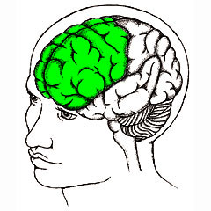
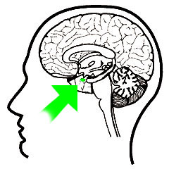
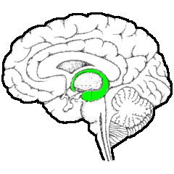
Etiology
Neuroanatomical differences
  White matter hyperintensities.
    Small abnormal areas in the white matter of the brain (especially in the frontal lobe).
  Smaller amygdala
  Decreased hipocampal volume
Hajek et al. (2005); Pavuluri et al. (2005)
Notes:
White matter hyperintensities: small abnormal areas in the white matter of the brain (especially in the frontal lobe) as seen using magnetic resonance imaging. These abnormalities may be caused by the loss of myelin or axons.
The evidence for involvement of the amygdala early in the course of the disease is fairly strong. Involvement of the amygdala in BD is consistent with its central role in emotional and social behavior (assigning emotional valence to stimuli and memories, facilitating encoding). The amygdala plays a key role in emotions and forming emotional memories. This almond-shaped structure integrates your senses and links them with your emotions. It also affects basic behaviors such as feeding, sexual arousal, and the “fight-or-flight” reaction to stress.
The hippocampus is a horseshoe-shaped brain structure involved in memory, learning, and emotion. It forms new memories and organizes them with related memories and emotions.
Images “Partners HealthCare System” Available http://www.wiredtowinthemovie.com/mindtrip_xml.html

Slide 41
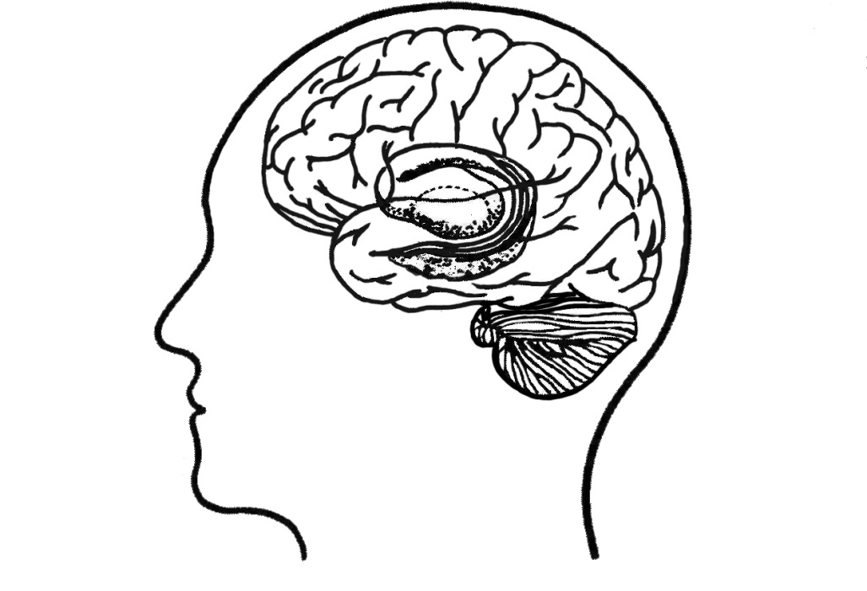
Etiology
Neuroanatomical differences
  Reduced gray matter volume in the dorsolateral prefrontal cortex (DLPFC)
  Bilaterally larger basal ganglia
    Specifically larger putamen
DLPFC
Basal Ganglia
Hajek et al. (2005); Pavuluri et al. (2005)
Notes:
Reduced gray matter volume in the DLPFC
The evidence for involvement of the striatum early in the course of illness is strong. These brain areas have been implicated in the modulation of socially appropriate emotional behavior. Increased striatal volume may be compensatory to a deficit in the fermentation from the frontal lobes or to deficits downstream within the circuitry involving the pallidum and thalamus.
Images “Partners HealthCare System” Available http://www.wiredtowinthemovie.com/mindtrip_xml.html

Slide 42
Diagnosing Bipolar Disorders
Between 1% and 2.6% of all adults in the world suffer from a bipolar disorder at any given time, and as many as 4% over the course of their lives
  Bipolar I seems to be a bit more common than Bipolar II
The disorders are equally common in women and men
  Women may experience more depressive episodes and fewer manic episodes than men and rapid cycling is more common in women
The disorders are more common among people with low incomes than those with high incomes
Comer, Abnormal Psychology, 8e DSM-5 Update

Slide 43
Prognosis
With respect to prognosis …, [early onset bipolar spectrum disorder] may include a prolonged and highly relapsing course; significant impairments in home, school, and peer functioning; legal difficulties; multiple hospitalizations and increased rates of substance abuse and suicide
In short, children with [early onset bipolar spectrum disorder] have a chronic brain disorder that is biopsychosocial in nature and, at this current time, cannot be cured or grown out of
Lofthouse & Fristad (2006, p. 213-214)
Notes:
Pediatric bipolar disorder tends to be more debilitating with poorer outcomes.
Juvenile BPD is much more chronic & has a very early onset age, with severe impairment, a great deal of emotional lability & impulsivity. They seem to have a more severe and complicated course of their illness. Suicidality (ideation/attempts) is shown to be more frequent in individuals with an onset of the disorder prior to age 18.
Adult onset BPD tends to be episodic with shorter, more distinct episodes.
Outcomes for individuals with broad phenotype (subsyndromal) also display significant impairment. Negative consequences exist for these individuals in the ability to cope with the demands for their ability to adjustment required during youth.

Slide 44
Prognosis
Outcome by subtype (research with adults)
Bipolar Disorder I
  More severe; tend to experience more cycling & mixed episodes; experience more substance abuse; tend to recover to premorbid level of functioning between episodes.
Bipolar Disorder II
  More chronic; more episodes with shorter inter-episode intervals; more major depressive episodes; typically present with less intense and often unrecognized manic phases; tend to experience more anxiety.
Cyclothymia
  Can be impairing; often unrecognized; many develop more severe form of Bipolar illness.
Bipolar Disorder Not Otherwise Specified (NOS)
  Largest group of individuals
Notes:
BP I is the more classic form of BD typically with clearly recognizable and distinguished episodes of depression and mania. BP I= is thought to be more severe: experience more cycling or mixed episodes (significant 51 vs 30%); tend to have significantly more severe affective episodes (as evidenced by more hospitalization, lower Global Assessment Scale scores, and a higher prevalence of psychotic features); experience slightly more substance abuse (50 comp to 40%); tend to recover to their premorbid level of psychosocial functioning between episodes.
BP II= thought to be more chronic- experience more major depressive episodes (thought to be the depressive pole of the bp spectrum; significant difference with 74 vs.50%); tend to have more episodes with shorter inter-episode intervals; experience more anxiety (38 comp to 23%) especially social phobias (Judd, et al., 2003).
Cyclothymia is characterized by chronic fluctuating moods involving periods of hypomania and depression. The periods of both depressive and hypomanic symptoms are shorter, less severe, and do not occur with regularity as experienced with bipolar II or I. However, these mood swings can impair social interactions and work. Many, but not all, people with cyclothymia develop a more severe form of bipolar illness.
BP: NOS-remember this is our catch-all for kids. It is the largest group of BP disorders, because of the variety of individuals with this dx, it is difficult to generalize about outcomes at this point.

